Slide 1
Amirhossein Joghataei
Think-on-Graph¹ - ICLR 2024
Thesis Report - 25 Farvardin
¹ Think-on-Graph: Deep and Responsible Reasoning of Large Language Model on Knowledge Graph

Slide 2
Content
Introduction
Methods
Dataset and Models
Results
Limitation
Future Work

Slide 3
Introduction

Slide 4
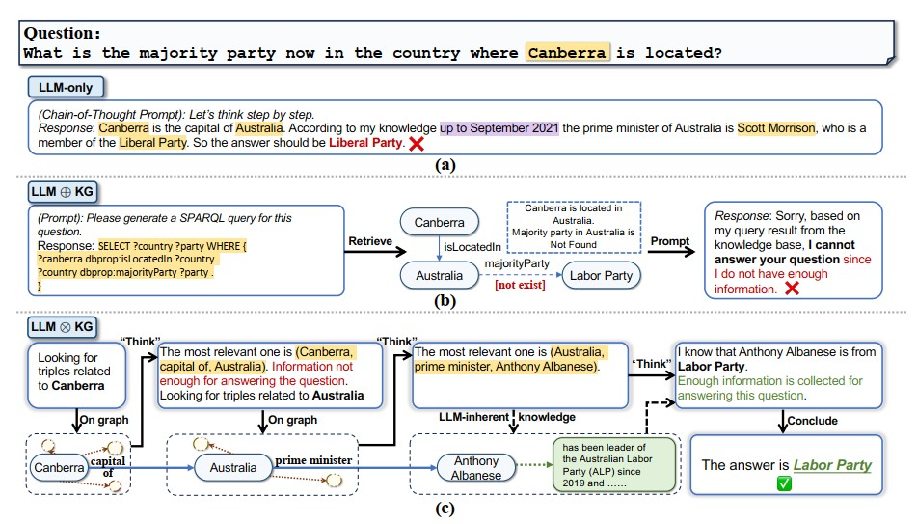
LLM⊕KG vs LLM ⊗ KG

Slide 5
Methods

Slide 6
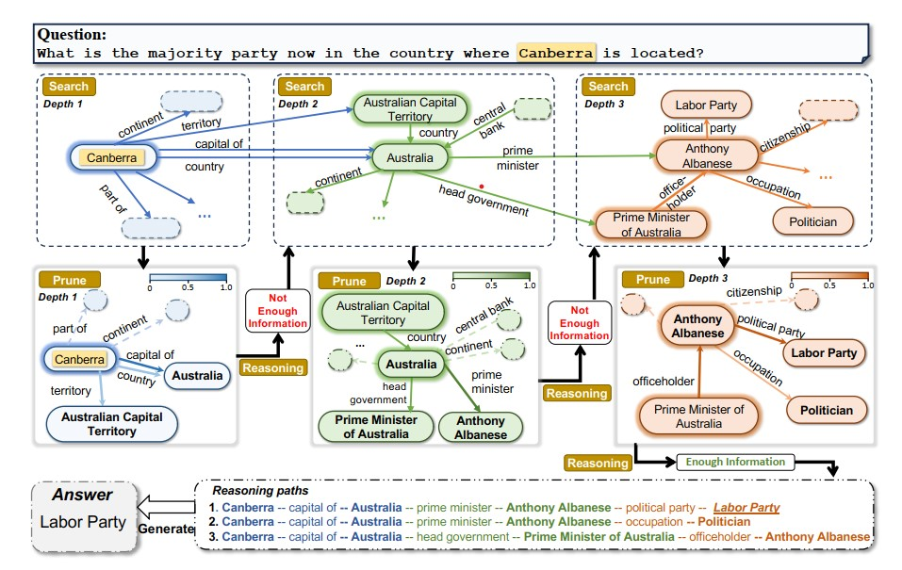
ToG

Slide 7
Exploration
Reasoning
Relation Exploration: beam search with depth of one and width of N
Search: use two queries
Prune: select top relations with LLM
Entity Exploration: use LLM beam search
Search: find set of entity with querying
Prune: select best entity with LLM
Time order = N LLMs call for prune
Prompt LLM to evaluate the current reasoning path.
Positive: generate answer with current path
Negative: repeat process
End of Depth: use LLM for generate
Total Time = 2ND +D +1

Slide 8
ToG-R
With the reference from (Lan et al., 2022), use just Relations
Remove entity prune from exploration
Select N random entity from entities
Time order = ND + D +1

Slide 9
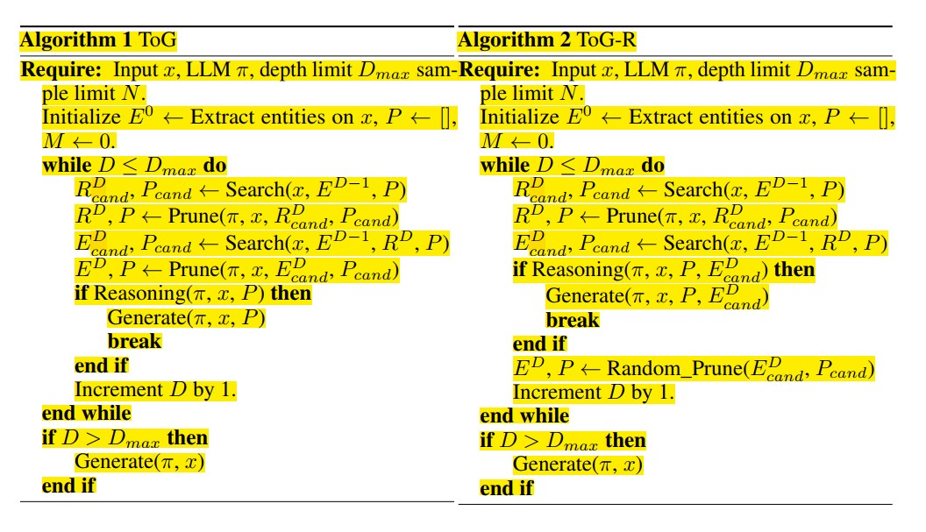
Algorithm

Slide 10
Dataset and Models

Slide 11
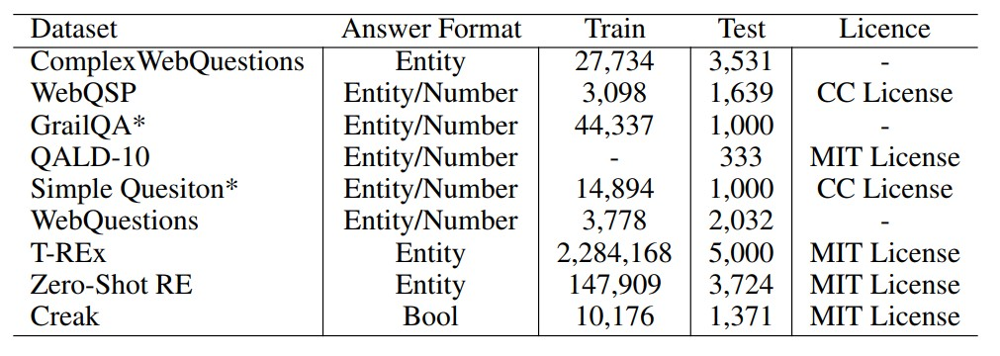
Datasets

Slide 12
Methods Selected for Comparison
Standard prompting (IO prompt)
Chain-of-Thought (CoT prompt)
Self-Consistency
Previous SOTA among all prompting-based methods
Previous SOTA among all fine-tuning methods

Slide 13
Usage Models
LLMs
GPT-3.5-turbo
GPT-4
Llama-2-70B-chat
Knowledge Graph
Freebase for CWQ, WebQSP, GrailQA, Simple Questions, and Webquestions
Wikidata for for QALD10-en, T-REx, Zero-Shot RE and Creak

Slide 14
Results

Slide 15
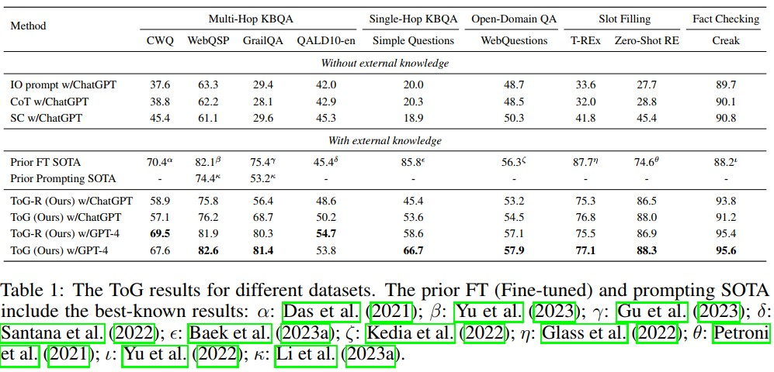
Results

Slide 16
Ablation Study
Use more study of ToG on CWQ and WebQSP dataset
Do search depth and width matter for ToG?
Depth = 1, 2, 3, 4
Do different KGs affect ToG’s performance?
Freebase and Wikidata
Searching and pruning is challenging in larger KG like Wikidata
How do different prompt designs affect ToG?
Triples, Sequences, Sentences
Comparing the effects from different pruning tools
BM25, SentenceBERT and ChatGPT
Faster but has nearly 10% error

Slide 17
Limitation

Slide 18
Limitation
ToG is efficient for knowledge-intensive tasks but not all task, e.g., arithmetic
Need better Evaluation method to evaluate ToG, e.g., “china” vs “Beijing”
Underuse of Topological Structure Information
Correct Paths but Wrong Answer
It can be from inherent factors within the LLM or a potential deficiency in the current prompt
Reliance on Topic Entities
The Cost of LLM Calls

Slide 19
Future Works

Slide 20
Future Works
Enable ToG to conduct cross-KG explorations, especially when there are a large number of overlapping
The diversity of explored reasoning paths may potentially impact the ultimate performance
For a large-scale KG, such as Wikidata, it is advisable to first perform a coarse ranking followed by a refined ranking
significant performance boost when reranking is introduced in the search process(Baek et al., 2023a)
Construct an open-source framework, which facilitates knowledge editing of the KGs during the interactive process of LLMs and KGs
Use more Advanced Search Algorithms like graph search

Slide 21
Thank you

